Slide 1

Trend Analysis of Developer Skills in IT
Aidil Sarjanisham
26th January 2025

Slide 2



REPORT OUTLINE
Executive Summary
Introduction
Methodology
Results
Visualisation – Charts
Dashboard
Discussion
Findings & Implications
Conclusion
Appendix

Slide 3

EXECUTIVE SUMMARY
This report analyses the usage of key web frameworks, cloud platforms, and databases among developers, based on survey data. The findings reveal that Microsoft SQL Server, PostgreSQL, and MySQL are the most commonly used databases, while Spring Boot, React, and ASP.NET Core dominate the web frameworks space. Additionally, cloud platforms like AWS, Microsoft Azure, and Google Cloud are the leading choices for developers.
The majority of respondents are from the 25-34 age group and hold a Bachelor’s degree, indicating a strong presence of early-career professionals with formal education in the industry. These findings highlight the current tech landscape, with a clear preference for widely adopted technologies and cloud platforms.
The report also explores trends in developer education, training, and future opportunities in emerging tools. As technology evolves, developers are encouraged to focus on cloud and web development skills to stay competitive in the job market.

Slide 4

INTRODUCTION
Project Overview
Analysis of emerging and future skill requirements in the rapidly evolving IT industry.
Focus on identifying trends in in-demand programming languages and database technologies
Objectives
Provide actionable insights to help the organization stay competitive in the tech landscape.
Highlight key skill trends to inform business and training strategies.

Slide 5

METHODOLOGY
Data Sources
Naukri.com: Extracted job postings using API.
IBM Popular Programming Languages and Salary website: Web scraped with Beautiful Soup.
Stack Overflow Developer Survey: Focused on key sections such as compensation, programming languages, databases, job satisfaction, and age.
Tools and Technologies Utilised
Python: Pandas, Numpy, Matplotlib, Seaborn
Microsoft Excel
SQL
IBM Cognos Analytics
Data Wrangling
Cleaned data by removing null values, standardizing formats, and ensuring correct data types.
Normalized numeric data and aggregated key metrics
Encoded categorical data
Handled outliers
Addressed missing data
Engineered features
Removed duplicate records for dataset accuracy.
Data Collection
Combined data from APIs, web scraping, and downloaded survey datasets.
Selected relevant variables aligned with project objectives.

Slide 6
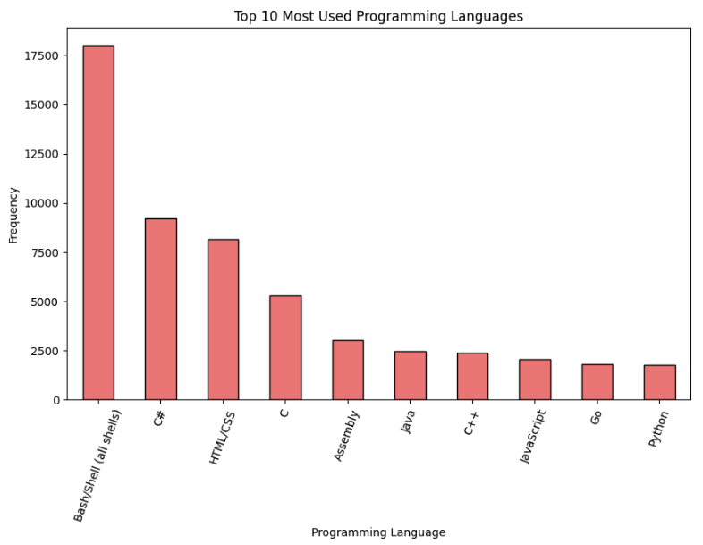
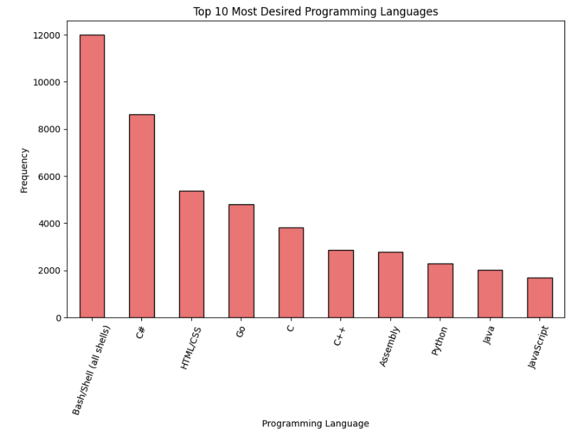
PROGRAMMING LANGUAGE TRENDS
< Bar chart of top 10 programming languages for the next year goes here.>

Slide 7
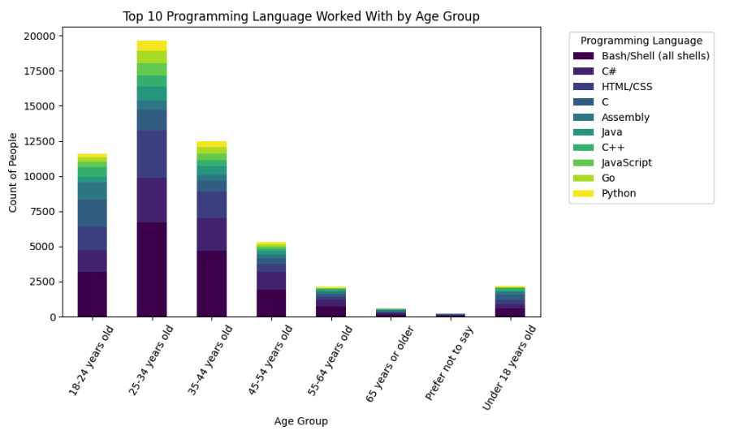
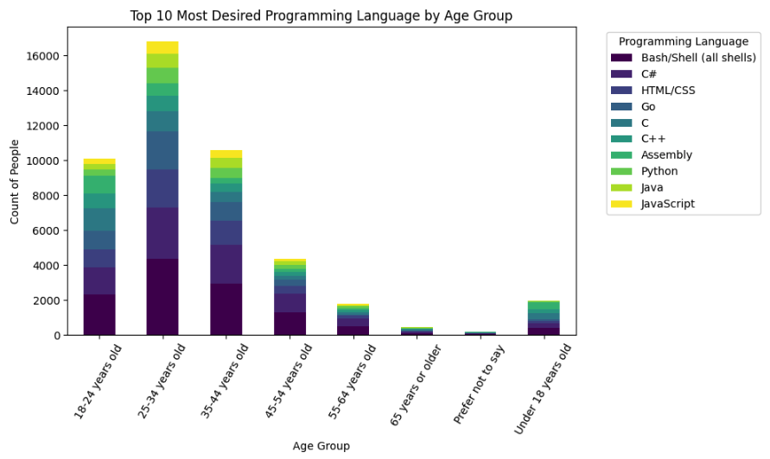
PROGRAMMING LANGUAGE TRENDS BY AGE GROUP
< Bar chart of top 10 programming languages for the next year goes here.>

Slide 8
PROGRAMMING LANGUAGE TRENDS - FINDINGS & IMPLICATIONS
The top 3 most used programming languages amongst respondents are Bash, C# and HTML/CSS.
The 3 least used programming languages amongst respondents are JavaScript, Go and Python.
The Majority of Respondents using Bash, C# and HTML/CSS fall in the age group of 25-34 years old.
The same age group also holds majority desire to work Bash, C# and HTML/CSS.
Popularity of Bash, C#, and HTML/CSS:
Industry Demand: High demand in web development and system administration roles.
Age Group Insight (25-34 years old):
Training Focus: Programs should emphasize these languages for this key age group.
Growth Potential:
Diversification: Learning less-used languages can open new job opportunities.

Slide 9
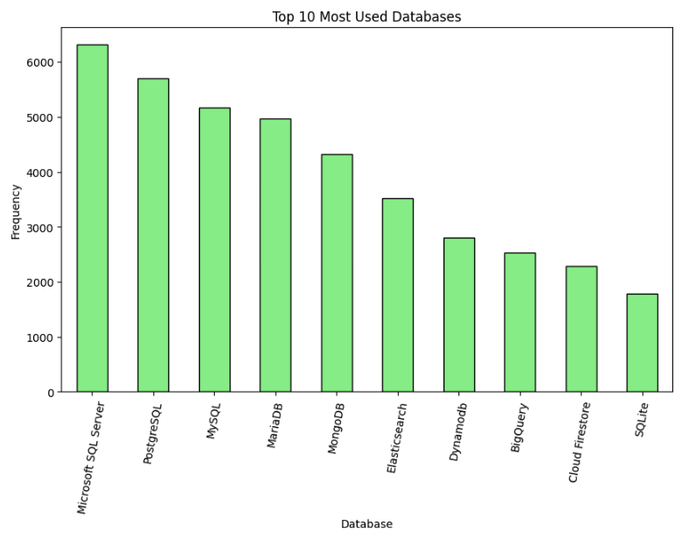
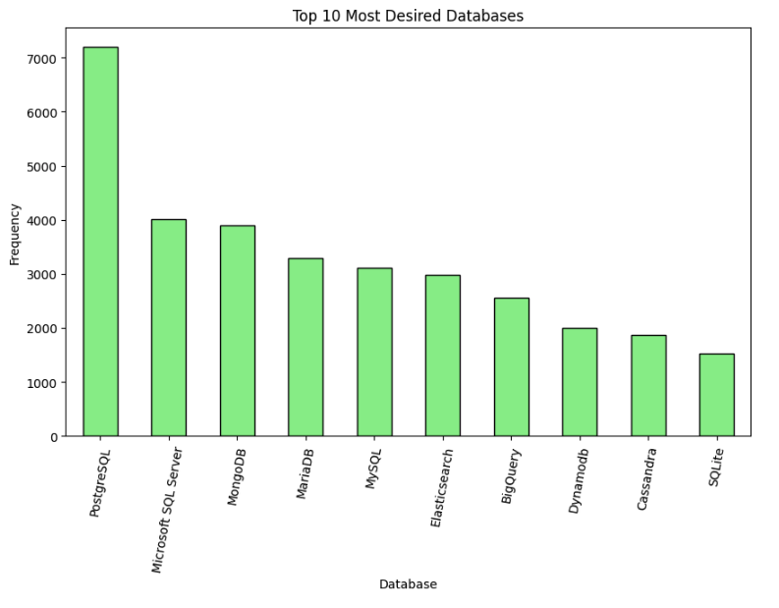
DATABASE TRENDS

Slide 10
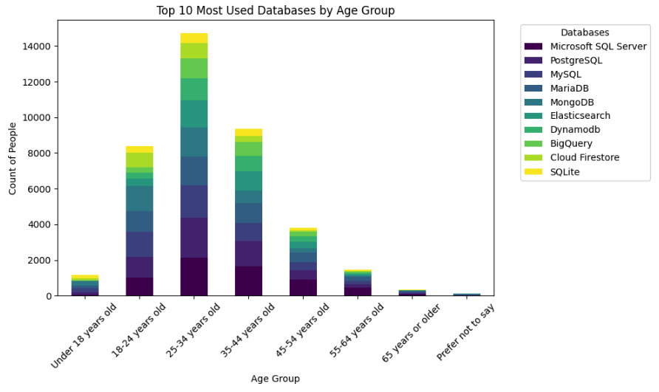
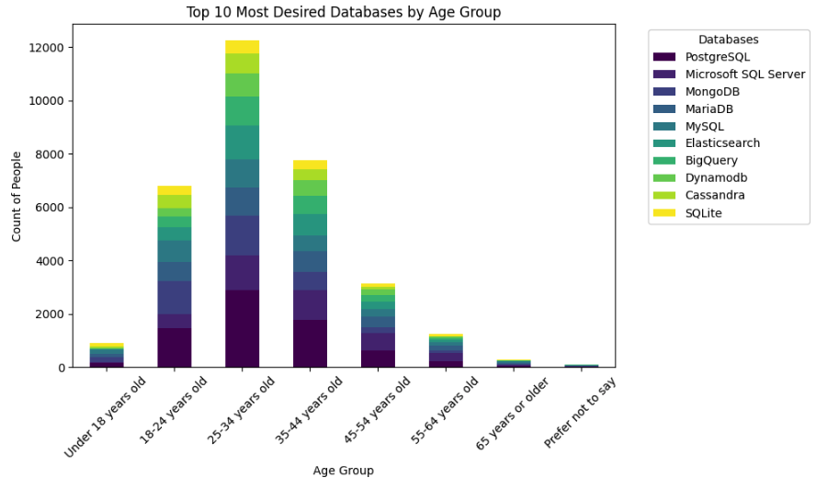
DATABASE TRENDS BY AGE GROUP

Slide 11
DATABASE TRENDS - FINDINGS & IMPLICATIONS
The top 3 most used databases amongst respondents are Microsoft SQL Server, PostgreSQL and MySQL.
The 3 least used programming languages amongst respondents are BigQuery, Cloud Firestore and SQLite.
The Majority of Respondents using Microsoft SQL Server, PostgreSQL and MySQL fall in the age group of 25-34 years old.
The same age group also holds majority desire to work Microsoft SQL Server, PostgreSQL and MySQL.
Most Used Databases (Microsoft SQL Server, PostgreSQL, MySQL):
These databases are essential for backend development and database administration roles.
Less Used Databases (BigQuery, Cloud Firestore, SQLite):
These databases have less adoption but may offer niche opportunities, particularly in cloud-based and mobile app development.
Age Group Insight (25-34 years old):
This age group leads in both using and wanting to work with these databases, indicating strong career interest and potential for training programs to focus on these technologies.

Slide 12
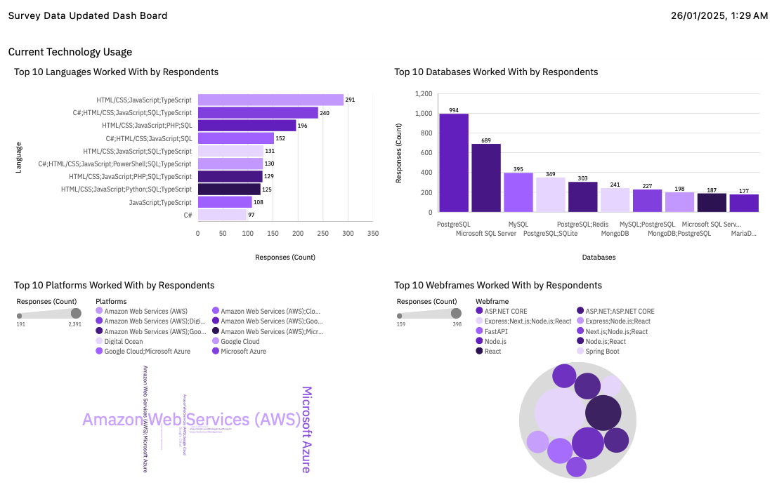
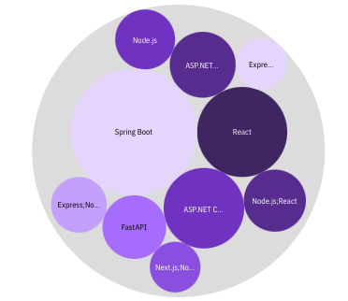
CURRENT TECHNOLOGY USAGE

Slide 13
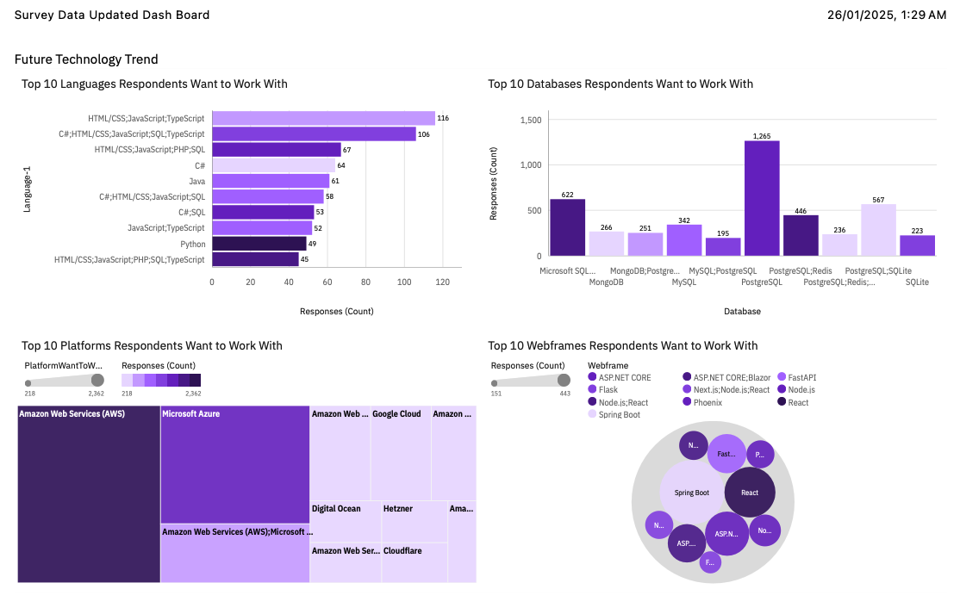
FUTURE TECHNOLOGY TRENDS

Slide 14
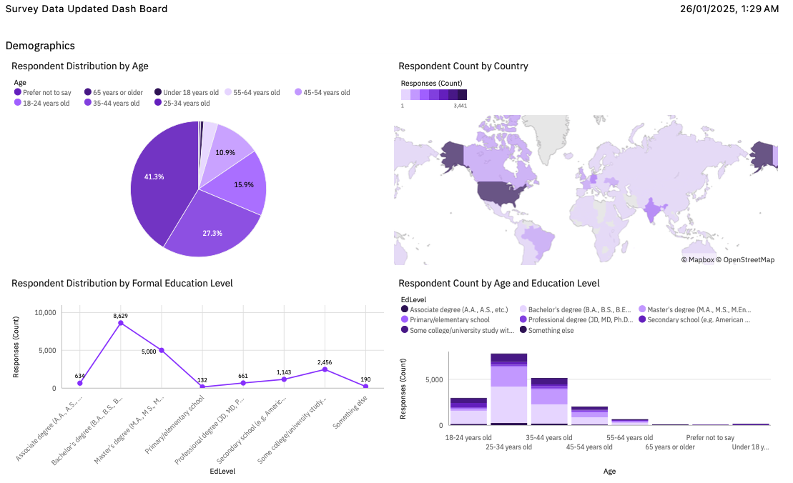
DEMOGRAPHICS

Slide 15
OVERALL FINDINGS & IMPLICATIONS
The top 3 most used web frames amongst respondents are Spring Boot, React and ASP.NET Core.
The top 3 most used platforms amongst respondents are Amazon Web Services (AWS), Microsoft Azure and Google Cloud.
The majority of respondents originate from America.
The majority of respondents hold a formal education level of Bachelor’s Degree.
Most Used Web Frameworks (Spring Boot, React, ASP.NET Core):
These frameworks are in high demand for web development and enterprise applications.
Most Used Platforms (AWS, Microsoft Azure, Google Cloud):
Cloud computing skills are essential for developers working on scalable, cloud-based solutions.
Majority of Respondents from America:
American markets are likely the primary focus for web development and cloud-based solutions.
Majority Hold a Bachelor’s Degree:
This indicates that higher education may play a key role in accessing tech roles.

Slide 16

DISCUSSION
1. Key Findings:
What factors might explain the dominance of SQL-based databases in developer communities?
2. Technology Adoption:
Why do frameworks like Spring Boot, React, and ASP.NET Core remain the most used?
3. Age Group Influence:
What does the strong representation of the 25-34 age group in using and desiring to work with these technologies tell us about the future of tech development?
4. Implications for Education and Training:
How should training programs evolve to meet the demands of developers?
5. Regional Trends:
With the majority of respondents from the U.S., how might global trends differ?
6. Looking Ahead:
What emerging technologies might disrupt the current landscape?

Slide 17

CONCLUSION
Industry Trends: Popular technologies like Microsoft SQL Server, PostgreSQL, MySQL, Spring Boot, React, and major cloud platforms (AWS, Azure, Google Cloud) dominate, reflecting the demand for scalable web and cloud solutions.
Specialization Opportunities: Emerging platforms like BigQuery and Cloud Firestore offer niche career opportunities in data analytics and cloud-native development.
Demographic Insight: The 25-34 age group is central to technology adoption, highlighting the importance of targeting this group in workforce development and training.
Education Pathways: A Bachelor’s degree remains common, showing that formal education plays a key role in accessing tech careers.
Global Landscape: The majority of respondents from America indicates that U.S. trends influence global tech practices and hiring preferences.

Slide 18

APPENDIX

Slide 19
POPULAR LANGUAGES

